Slide 1
Evaluation and Management of Acute Pericarditis
DR.GHYATH AL AGHA
CARDIOLOGIST

Slide 2
INTRODUCTION

Slide 3
The pericardium is a fibroelastic sac made up of visceral and parietal layers separated by a (potential) space, the pericardial cavity. In healthy individuals, the pericardial cavity contains 15 to 50 mL of an ultrafiltrate of plasma.

Slide 4
Acute pericarditis is a common disorder in several clinical settings, and may be the first manifestation of an underlying systemic disease..

Slide 5
ETIOLOGY

Slide 6
The pericardium may be involved in a large number of systemic disorders or may be diseased as an isolated process

Slide 7
Idiopathic
In most case series, the majority of patients are not found to have an identifiable cause of pericardial disease. Frequently such cases are presumed to have a viral or autoimmune etiology.

Slide 8
Infections
Viral
Coxsackievirus, echovirus, adenovirus, EBV, CMV, influenza, varicella, rubella, HIV, hepatitis B, mumps, parvovirus B19, vaccina (smallpox vaccination)

Slide 9
Bacterial
Staphylococcus
Streptococcus
pneumococcus
Haemophilus
Neisseria (gonorrhoeae or meningitidis)
Chlamydia (psittaci or trachomatis)
Legionella
Tuberculosis
Salmonella
Mycoplasma
Lyme disease

Slide 10
Fungal
  Histoplasmosis, aspergillosis, blastomycosis, coccidiodomycosis, actinomycosis, nocardia, candida

Slide 11
Parasitic
Echinococcus, amebiasis, toxoplasmosis

Slide 12
Radiation

Slide 13
Neoplasm
Metastatic - Lung or breast cancer, Hodgkin's disease, leukemia, melanoma
Primary - Rhabdomyosarcoma, teratoma, fibroma, lipoma, leiomyoma, angioma
Paraneoplastic

Slide 14
Cardiac
A.Early infarction pericarditis
B. Late postcardiac injury (Dressler's syndrome )
C. Myocarditis

Slide 15
Trauma
A. Blunt
B. Penetrating
C. Iatrogenic - Catheter and pacemaker perforations, cardiopulmonary resuscitation, post-thoracic surgery

Slide 16
Autoimmune
A. Rheumatic diseases - including lupus, rheumatoid arthritis, vasculitis, scleroderma, mixed connective tissue disease
B. Other - Wegener's granulomatosis, polyarteritis nodosa, sarcoidosis, inflammatory bowel disease (Crohn's, ulcerative colitis), Whipple's, giant cell arteritis, Behcet's disease

Slide 17
Drugs
A. Procainamide, isoniazid, or hydralazine as part of drug-induced lupus
B. Other - cromolyn sodium, dantrolene, methysergide, anticoagulants, thrombolytics, phenytoin, penicillin, ,mesalazine ,cyclosporin ,phenylbutazone, doxorubicin

Slide 18
Metabolic
      A. Hypothyroidism
      B. Uremia

Slide 19
DIAGNOSTIC CRITERIA AND CLINICAL PRESENTATION of ACUTE PERICARDITIS

Slide 20
Acute Pericarditis
at least 2 criteria of 4 should be present

Slide 21
1. Typical chest pain
2. Pericardial friction rub
3. Suggestive ECG changes (typically widespread ST segment elevation)
4. New or worsening pericardial effusion
(Pericardial effusion confirms the clinical diagnosis but its absence does not exclude it.)

Slide 22
Chest pain
The chest pain of acute pericarditis is typically fairly sudden in onset and occurs over the anterior chest. It is often pleuritic in nature, being sharp and exacerbated by inspiration. However, dull, oppressive pain, which is difficult to distinguish from that of myocardial ischemia, can occur.
The pain may decrease in intensity when the patient sits up and leans forward

Slide 23
Pericardial friction rub
A pericardial friction rub is highly specific for acute pericarditis. The sensitivity is variable, varying in part with the frequency of auscultation since rubs tend to vary in intensity and can come and go over a period of hours.
Pericardial rubs may be easier to hear in patients without a pericardial effusion, but this finding is not universal and is not well-documented.
In a report of 100 patients with acute pericarditis, a pericardial rub was present in 34 of 40 (85 percent) without an effusion, a prevalence considerably higher than in some other series.

Slide 24
Pericardial friction rubs are said to be generated by friction of the two inflamed layers of the pericardium, but even a large pericardial effusion does not necessarily prevent a friction rub. Thus, this commonly offered explanation for its mechanism may be an oversimplification.

Slide 25
Pericardial friction rubs occur during the maximal movement of the heart within its pericardial sac. Thus, the classic friction rub consists of three phases, corresponding to movement of the heart during atrial systole (which is not heard in patients with atrial fibrillation), ventricular systole, and in
the rapid filling phase of early ventricular diastole.

Slide 26
However, some rubs are present only during one (one component) or two phases (two components) of the cardiac cycle

Slide 27
Pericardial rubs have a superficial scratchy or squeaking sound that is best heard with the diaphragm of the stethoscope.
They can be localized or widespread, but are usually best heard over the left sternal border..

Slide 28
The intensity of the rub frequently increases after application of firm pressure with the diaphragm, during suspended respiration, and with the patient leaning forward or resting on elbows and knees. This last maneuver is designed to increase contact between visceral and parietal pericardium, but is seldom used in practice since it is cumbersome for the patient

Slide 29


Slide 30
Electrocardiogram
The electrocardiogram in acute pericarditis
evolves through four stages

Slide 31
Stage 1
Seen in the first hours to days
Characterized by diffuse ST elevation (typically concave up) with reciprocal ST depression in leads aVR and V1
There is also an atrial current of injury, reflected by elevation of the PR segment in lead aVR and depression of the PR segment in other limb leads and in the left chest leads, primarily V5 and V6. Thus, the PR and ST segments typically change in opposite directions, although the PR deviations, which are highly specific although not sensitive, are frequently overlooked.

Slide 32
Stage 2
Characterized by normalization of the ST and PR segments.

Slide 33
Stage 3
Characterized by the development of diffuse T wave inversions, generally after the ST segments have become isoelectric. However, this stage is not seen in some patients.

Slide 34
Stage 4
The ECG may become normal OR the T wave inversions may persist indefinitely

Slide 35
Treatment can accelerate or alter ECG progression.
The duration of the ECG changes in pericarditis also depends upon its cause and the extent of the associated myocardial damage

Slide 36
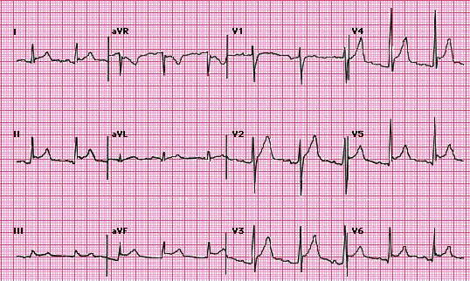

Slide 37

Atypical ECG changes
Atypical ECG such as localized ST-elevation and T-wave inversion before ST-segment normalization occur in a minority of patients with acute pericarditis without myocardial involvement. These changes can simulate changes found in acute coronary syndrome.

Slide 38
Laboratory signs of inflammation
Common in patients with acute pericarditis.
These include elevations in the white blood cell count, erythrocyte sedimentation rate, and serum C-reactive protein concentration.

Slide 39
Cardiac Biomarkers
Acute pericarditis may be associated with increases in serum biomarkers for myocardial injury such as elevations in serum cardiac troponin I (cTnI) with or without increased MB fraction of creatine kinase (CK-MB). Such patients should be considered to have myopericarditis.

Slide 40
Diagnostic criteria for myopericarditis

Slide 41
1. Definite diagnosis of acute pericarditis, PLUS
2. Suggestive symptoms (dyspnea, palpitations, or chest pain) and ECG abnormalities beyond normal variants, not documented previously (ST/T abnormalities, supraventricular or ventricular tachycardia or frequent ectopy, atrioventricular block), OR focal or diffuse depressed LV function of uncertain age by an imaging study
3. Absence of evidence of any other cause
4. One of the following features: evidence of elevated cardiac enzymes (creatine kinase-MB fraction, or troponin I or T), OR new onset of focal or diffuse depressed LV function by an imaging study, OR abnormal imaging consistent with myocarditis (MRI with gadolinium, gallium-67 scanning, anti-myosin antibody scanning)

Slide 42
Causes of ST segment elevation

Slide 43
Causes of ST segment elevation
Myocardial ischemia or infarction
Noninfarction, transmural ischemia (Prinzmetal's angina pattern or acute takotsubo cardiomyopathy)
Acute myocardial infarction (MI)
Post-MI (ventricular aneurysm pattern)
Previous MI with recurrent ischemia in the same area
Acute pericarditis
Normal "early repolarization variants"
Left ventricular hypertrophy or left bundle branch block (only V1-V2 or V3)
Other
Myocarditis (may look like myocardial infarction or pericarditis)
Brugada patterns (V1-V3 with right bundle branch block-appearing morphology)
Myocardial tumor
Myocardial trauma
Hyperkalemia (only leads V1 and V2)
Hypothermia (J wave/Osborn wave)

Slide 44

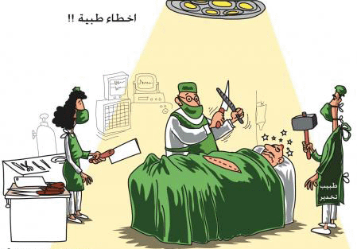
Distinction from acute myocardial infarction

Slide 45
Distinction from acute myocardial infarction
The electrocardiographic changes in acute pericarditis differ from those in acute ST elevation MI (STEMI) in the following ways These distinctions assume that the pericarditis does not occur during or soon after an acute MI

Slide 46
ACUTE PERICARDITIS
STEMI
The ST segment elevation begins at the J point, rarely exceeds 5 mm, and usually retains its normal concavity.
In other cases, ST segment rises obliquely in a straight line
Although similar patterns can occur with STEMI, the typical finding is convex (dome-shaped) ST elevation, a pattern not characteristic of acute pericarditis, that may be more than 5 mm in height

Slide 47
ACUTE PERICARDITIS
STEMI
The pericardium envelops the heart, and the ST-T changes are therefore more generalized, being present in most of the chest leads as well as leads I, aVL, II, III, and aVF
ST segment elevation in the precordial leads is most commonly seen in V5 and V6, and in decreasing frequency from V4 to V1 in precordial leads. In the limb leads, it is often more evident in leads I and II than in leads III, aVF, and aVL.
ST segment elevations are characteristically limited to either the anterolateral leads (I, aVL, V1 to V6) or the inferior (II, III, aVF) leads because of the localized area of the infarct

Slide 48
ACUTE PERICARDITIS
STEMI
Reciprocal ST segment changes, are not seen except in aVR and V1.
Often associated with reciprocal ST segment changes.

Slide 49
ACUTE PERICARDITIS
STEMI
ST segment elevation and T wave inversions do not generally occur simultaneously
ST segment elevation and T wave inversions are commonly seen

Slide 50
ACUTE PERICARDITIS
STEMI
The myocardial injury is more diffuse in and different areas of myocardium reflect different stages in the pattern of repolarization abnormality.As a result, varying degrees of T wave inversion OR ST segment elevation can be present concurrently in different leads
Leads facing the infarcted area tend to show the same stage of ST-T evolution

Slide 51
ACUTE PERICARDITIS
STEMI
PR elevation in aVR with PR depression in other leads due to a concomitant atrial current of injury is often seen
PR segment abnormalities are uncommon.

Slide 52
ACUTE PERICARDITIS
STEMI
Pathologic Q waves, are generaly not seen; as pericarditis generally causes only superficial inflammation, not frank myocardial necrosis. Abnormal Q waves are not seen unless there is concomitant myocarditis or preexisting cardiomyopathy or myocardial infarction
The abnormal Q waves in MI reflect the loss of positive depolarization voltages because of myocardial necrosis

Slide 53
ACUTE PERICARDITIS
STEMI
Hyperacute T waves, are not typical of pericarditis.
Hyperacute T waves can be seen.

Slide 54
Definite prolongation of the QT interval with regional T wave inversion (in the absence of drug effects or relevant metabolic disorders) favors the diagnosis of ischemia (or myopericarditis) over pericarditis alone.

Slide 55
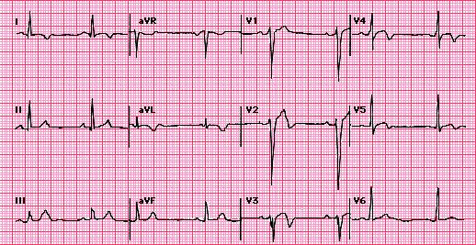

Slide 56
Distinction from early repolarization

Slide 57

Early Repolarization
Characterized by ST elevation of the J point, which represents the junction between the end of the QRS complex (termination of depolarization) and the beginning of the ST segment (onset of ventricular repolarization). As a result, there is elevation of the ST segment itself, which maintains its normal configuration. ST elevation is most often present in the mid to lateral chest leads (V3-V6), although many leads can be involved.

Slide 58
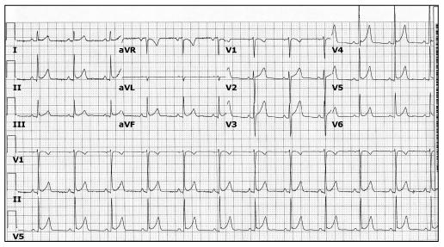

Slide 59
The normal early repolarization variant may be present in as many as 30 percent of young adults.
It is more likely to occur in men than women, in patients under age 40, and in individuals who are athletically active.

Slide 60
ACUTE PERICARDITIS
EARLY REPOLRRIZATION
ST elevations occur in both the limb and precordial leads in most cases.
About one-half of subjects have no ST deviations in the limb leads.

Slide 61
ACUTE PERICARDITIS
EARLY REPOLRRIZATION
PR deviation and evolution of the ST and T changes strongly favor pericarditis
Neither of which is seen in early repolarization

Slide 62
The ratio of ST elevation to T wave amplitude in lead V6
If the ratio exceeded 0.24, acute pericarditis is present (positive and negative predictive values were both 100 percent).

Slide 63
Echocardiogram
The echocardiogram is often normal in patients with the clinical syndrome of acute pericarditis unless it is associated with a pericardial effusion.
While the finding of a pericardial effusion in a patient with known or suspected pericarditis supports the diagnosis, the absence of a pericardial effusion or other echocardiographic abnormalities does not exclude it.

Slide 64
Chest x-ray
The chest x-ray is typically normal in patients with acute pericarditis.
Although patients with a substantial pericardial effusion may exhibit an enlarged cardiac silhouette with clear lung fields, this finding is uncommon in acute pericarditis since at least 200 mL of pericardial fluid must accumulate before the cardiac silhouette enlarges However, acute pericarditis should be considered in the evaluation of a patient with new unexplained cardiomegaly.

Slide 65
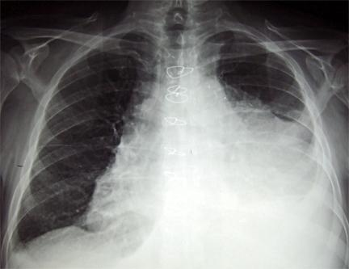
Chest x-ray of a pericardial effusion

Slide 66
INITIAL EVALUATION

Slide 67
Standard approach
Initial history and physical examination
This evaluation should consider disorders that are known to involve the pericardium, such as uremia, recent myocardial infarction (MI), and prior cardiac surgery. .………
The examination should pay particular attention to auscultation for a pericardial friction rub and the signs associated with tamponade.

Slide 68
Echocardiography
Echocardiography should be performed in all cases, and should be considered on an urgent basis if tamponade is suspected.
Even a small effusion can be helpful in confirming the diagnosis of pericarditis, although the absence of an effusion does not exclude the diagnosis. In addition, echocardiography can be particularly helpful if purulent pericarditis is suspected, if there is concern about myocarditis, or if there is chest x-ray evidence of cardiac enlargement, particularly if this is a new finding.

Slide 69
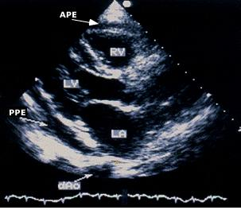

Slide 70
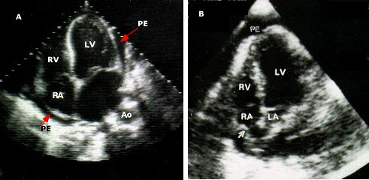

Slide 71
Additional testing should include
ECG in all cases
Chest x-ray in all cases
Tuberculin skin test or preferably, an interferon-gamma
release assay (eg, QuantiFERON TB assay) if not recently performed
Antinuclear antibody titer in selected cases
HIV serology in selected cases.
Blood cultures if fever higher than 38ºC (100.4ºF) or signs of sepsis

Slide 72
Determination of risk and need for hospitalization
Fever (>38ºC [100.4ºF]) and leukocytosis
Evidence suggesting cardiac tamponade
A large pericardial effusion (ie, an echo-free space of more than 20 mm)
Immunosuppressed state
A history of oral anticoagulant therapy
Acute trauma
Failure to respond within seven days to NSAID therapy Elevated cardiac troponin, suggestive of myopericarditis

Slide 73
TREATMENT

Slide 74
Patients with none of the high-risk features cited can be safely treated on an outpatient basis

Slide 75
In patients with an identified cause other than viral or idiopathic disease, specific therapy appropriate to the underlying disorder is indicated

Slide 76
NSAID
In the treatment of idiopathic or viral pericarditis, the goals of therapy are the relief of pain and resolution of inflammation and, if present, effusion.

Slide 77
Ibuprofen
Depending upon the severity of the pericarditis and individual medication response, 300 to 800 mg of ibuprofen every six to eight hours, which can be continued for weeks for recurrent or incessant attacks as needed.
NSAID dose tapering may be prescribed in an attempt to reduce the subsequent recurrence rate.
The 2004 ESC guidelines suggested ibuprofen as the preferred NSAID because of its rare side effects, favorable impact on coronary artery blood flow, and large dose range.

Slide 78
Aspirin
An alternative protocol consists of aspirin
800 mg every six to eight hours followed by gradual tapering of 800 mg every week for a treatment period of three to four weeks .
or
650 mg every four to six hours followed by gradual tapering of 650 mg every 5 days for a treatment period of three to four weeks.

Slide 79
In pericarditis associated with an acute MI, aspirin is preferred, and the use of an NSAID other than aspirin and glucocorticoids should probably be AVOIDED, since antiinflammatory therapy may impair scar formation.
Aspirin may also be the first choice in patients that require concomitant antiplatelet therapy for any reason.

Slide 80
With either regimen, gastrointestinal protection should be provided.
Misoprostol — The risk for NSAID-induced gastric or duodenal ulcer can be decreased with concomitant use of the prostaglandin E analog misoprostol.
100 µg three times daily or four times daily, and then to increase the dose as tolerated up to the maximum dose of 200 µg four times daily.

Slide 81
Proton pump inhibitors (PPIs) are useful for the prevention of NSAID-induced ulcers .
Omeprazole 20 mg
Lanzoprazole 15-30 mg
Esomeprazole 20-40 mg

Slide 82
Colchicine
colchicine is an optional additional treatment in patients with a first episode of acute idiopathic or viral pericarditis
0.5 to 1 mg twice on the first day, followed by
0.5 once or twice daily for three months
There are less common (<1 percent) side-effects to be considered (bone marrow suppression, hepatotoxicity, and myotoxicity).
Chronic renal insufficiency leading to increased colchicine levels appears to be the major risk factor for side effects

Slide 83
Glucocorticoids
Should be considered only if the patient is clearly refractory to NSAIDs and colchicine, and a specific cause for the pericarditis has been excluded
The 2004 ESC guidelines recommended that systemic steroid therapy be restricted to patients with the following conditions :
Acute pericarditis due to connective tissue disease Autoreactive (immune-mediated) pericarditis
Uremic pericarditis
prednisone 1 mg/kg/day when indicated with rapid tapering to reduce the risk of systemic side effects.

Slide 84
usually the tapering start at two to four weeks, after C-reactive protein normalization.
Slow prednisone tapering is critical and a proposed tapering scheme follows:
Daily dose >50 mg - tapered 10 mg/day every one to two weeks
Daily dose 25-50 mg - tapered 5-10 mg/day every one to two weeks
Daily dose 15-25 mg - tapered 2.5 mg/day every two to four weeks
Daily dose <15 mg - tapered 1.25 to 2.5 mg/day every two to six weeks

Slide 85
We generally add colchicine during glucocorticoid tapering and continue colchicine for several months after glucocorticoid discontinuation (ie, with a overall length of treatment of three months for acute pericarditis, six months in recurrent cases).

Slide 86
Pericardiocentesis
Pericardiocentesis is generally performed for one of
three reasons:
A -If moderate to severe tamponade is present, pericardiocentesis can be life saving.
B -If purulent, tuberculous, or neoplastic pericarditis is suspected.
C -If there is a persistent symptomatic pericardial effusion.

Slide 87
Summary of the European Society of Cardiology Guidelines on the Diagnosis and Management of Pericardial Heart Disease
.
Acute pericarditis
NSAIDs | Class I | Level B
Colchicineª | Class IIa | Level B
Systemic corticosteroids^{b} ª For initial attack and prevent of recurrences. ^{b} For connective tissue disease-associated, autoreactive, and uremic effusions. | Class IIa | Level B

Slide 88
Recurrent pericarditis
Colchicine | Class I | Level B
Systemic corticosteroids^{d} | Class IIa | Level C
Pericardiectomy^{e} ^{d} For recurrent pericarditis in patients in poor general condition or in frequent crises. ^{e} For frequent, highly symptomatic recurrences resistant to medical therapy. | Class IIa | Level B

Slide 89
Pericardial effusion
Pericardiocentesis for cardiac tamponade | Class I | Level B
Pericardiocentesis for smaller effusions | Class IIa | Level B

Slide 90
Analysis of pericardial fluid
Pericardial fluid and blood for bacteria | Class I | Level B
PCR, ADA, IF , lysozyme for tuberculosis | Class I | Level B
PCR, in situ hybridization for virus | Class IIa | Level B
Serum viral titers | Class IIb | Level B
Pericardial chemistry (specific gravity, protein, LDH, glucose) PCR, polymerase chain reaction; ADA, adenosine deaminase; IF , interferon gamma. LDH , lactate dehydrogenase | Class IIb | Level B

Slide 91
Specific forms of pericarditis
Corticosteroids for TB pericarditis | Class IIb | Level A
Pericardiocentesis for tamponade and large effusions unresponsive to dialysis | Class IIa | Level B
Pericardiocentesis for large neoplastic effusions | Class I | Level B
Diagnostic pericardiocentesis in suspected neoplastic effusion | Class IIa | Level B
Intrapericardial instillation of cytotoxic/sclerosing agent for neoplastic pericarditis | Class IIa | Level B
Radiation Rx for control of effusions in patients with radiosensitive tumors | Class IIa | Level B
Percutaneous balloon pericardiotomy for malignant effusions | Class IIa | Level B
Pleuropericardiotomy to drain malignant effusions | Class IIb | Level C
Surgical therapy of chylous effusion resistant to diet and pericardiocentesis | Class I | Level B
Thyroid hormone for effusion secondary to myxedema | Class I | Level B

Slide 92
PROGNOSIS
Patients with acute idiopathic or viral pericarditis have a good long-term prognosis.
Cardiac tamponade rarely occurs in patients with acute idiopathic pericarditis and is more common in patients with a specific etiologies such as neoplastic, tuberculous, or purulent pericarditis (up to 68 percent).
Constrictive pericarditis may occur in about 1 percent of patients with acute idiopathic pericarditis, and it is more common in patients with a specific etiology.

Slide 93

THANK
YOU

